Slide 1
Computing Technology

Slide 2

Notes:
Pictures made of little dots “pixels – zoom in to see them

Slide 5

Notes:
See the pixels! Love the pixels!

Slide 6
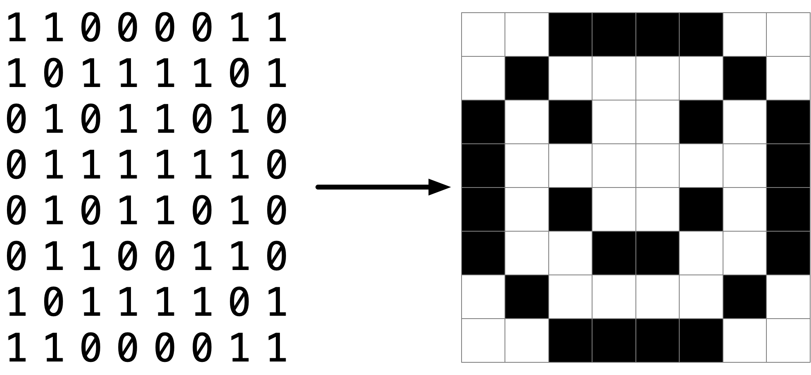
Notes:
This is how pixels are represented – file formats, jpeg etc, but BITMAP!! (smiley face)

Slide 9
pixel art
Notes:
Pixel art!

Slide 10
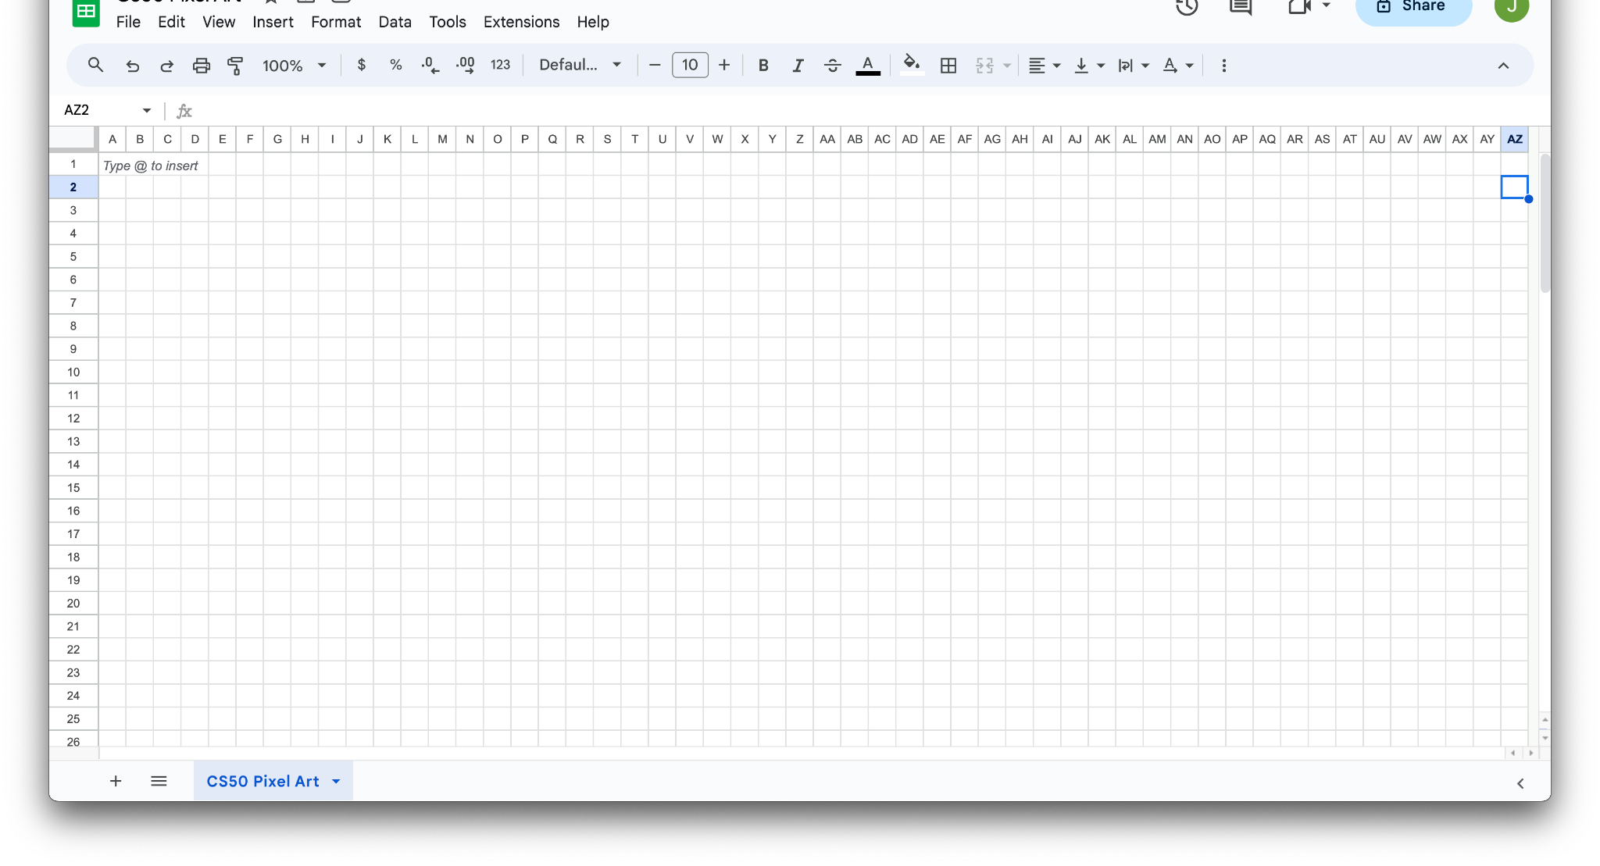
Notes:
Make your own with Excel!

Slide 11

Notes:
Pretty good example

Slide 12
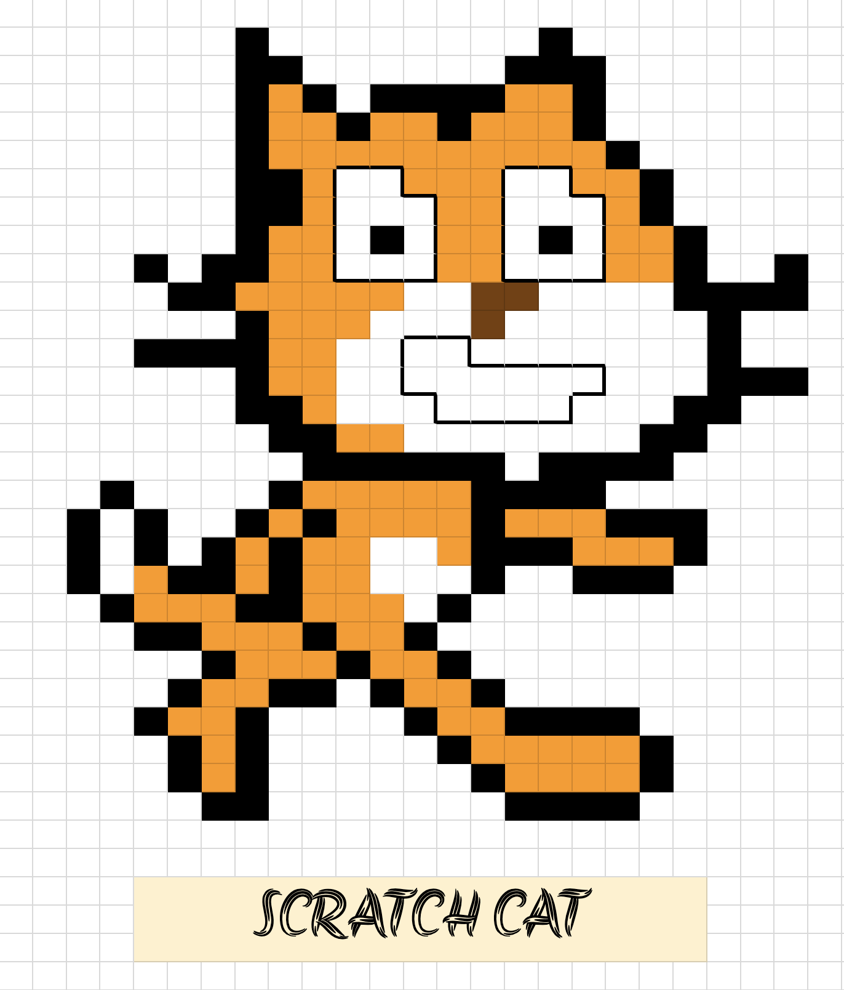

Slide 13


Slide 14


Slide 15
RGB
Notes:
Adding another “base”: hexidecimal

Slide 16
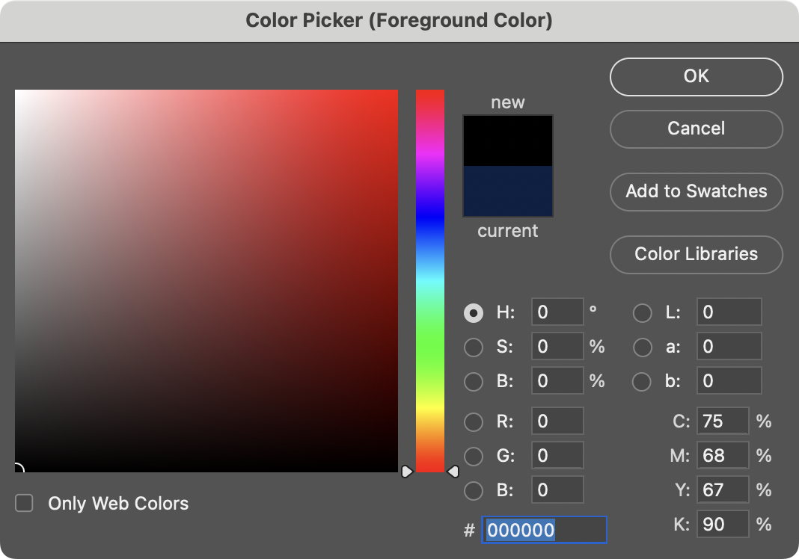
Notes:
Photoshop colour picker – notice the hash: hexadecimal colour representation
-notice the RGB spaces and representations

Slide 17
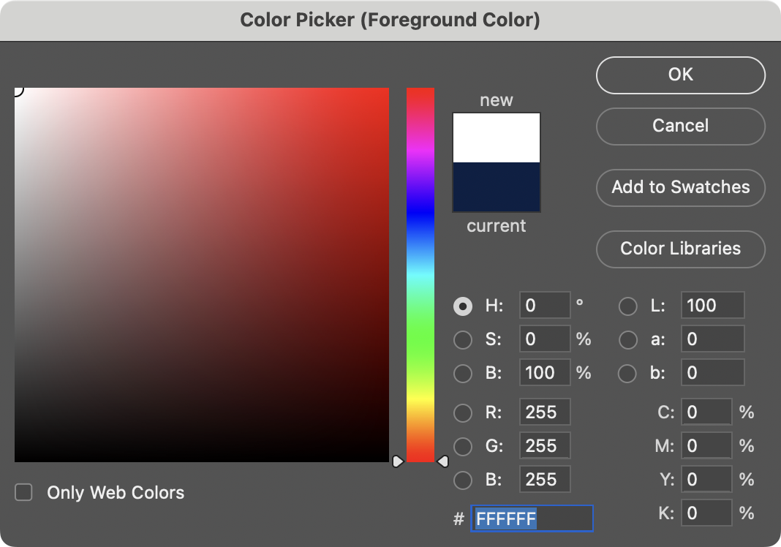
Notes:
White is 255 255 255. But what are these F's? hmmm

Slide 18
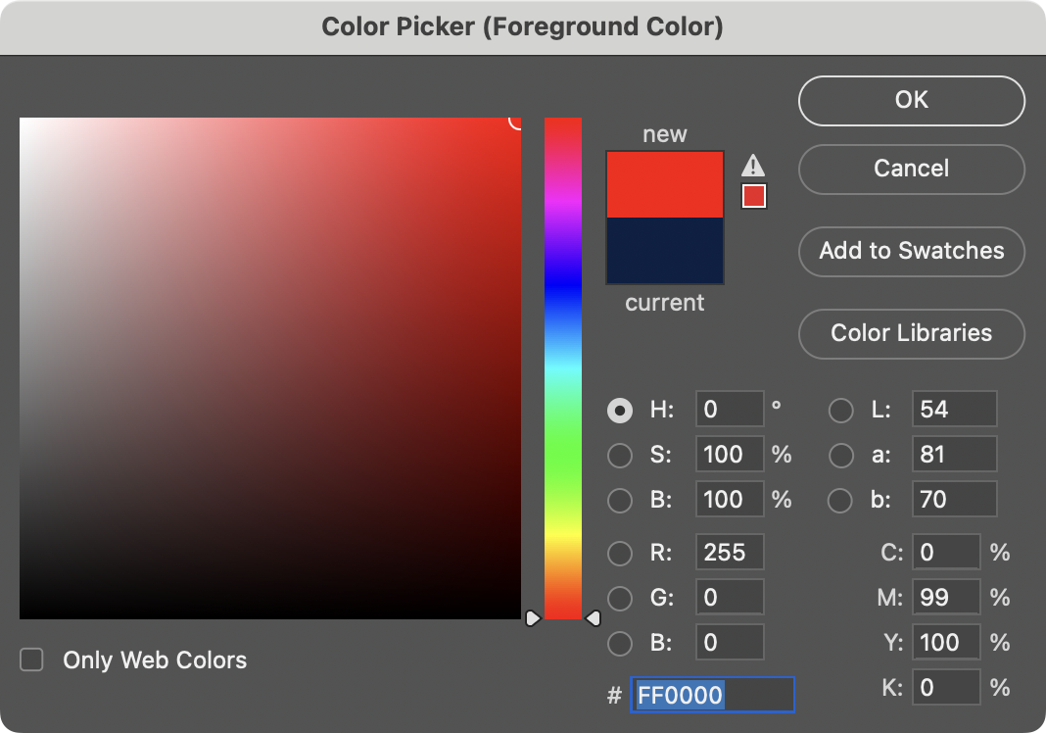

Slide 19
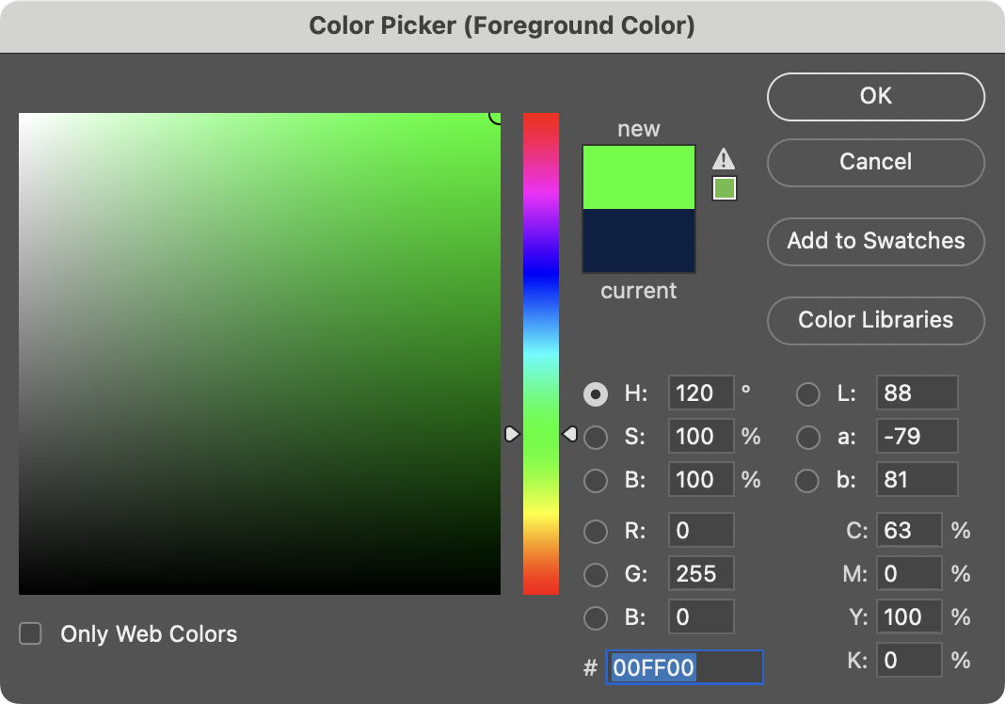

Slide 20
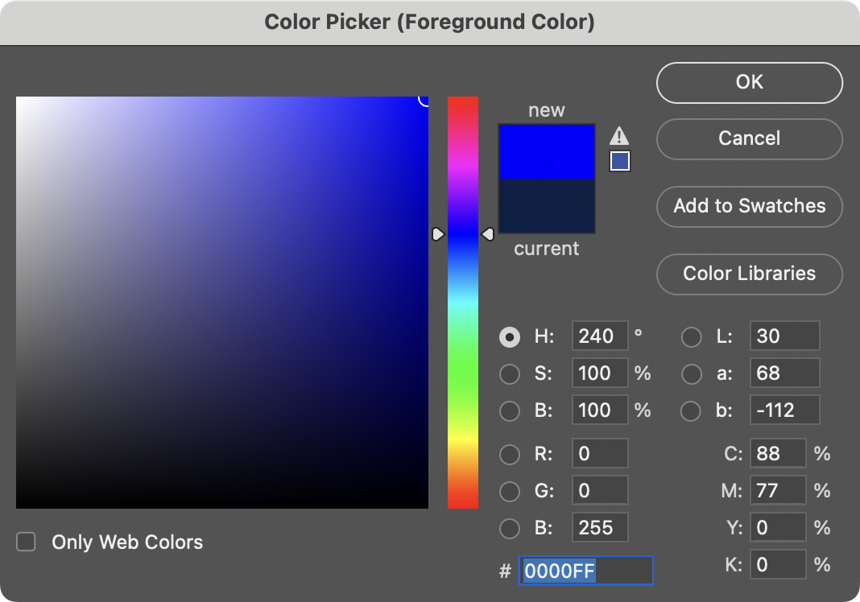
Notes:
But, what is with the “FF”?

Slide 21
0 1 2 3 4 5 6 7 8 9 A B C D E F
Notes:
Computer binary

Slide 22
0 1 2 3 4 5 6 7 8 9 A B C D E F
Notes:
Decimal numbers

Slide 23
0 1 2 3 4 5 6 7 8 9 A B C D E F
Notes:
Hexidecimal notations – extends numbers with letters
Single space for each number 0-15

Slide 24
0 1 2 3 4 5 6 7 8 9 a b c d e f

Slide 25
hexadecimal

Slide 26
base-16

Slide 27
16¹
16⁰
# #
Notes:
Let’s count in hex omgz!

Slide 28
16
1
# #

Slide 29
16
1
00

Slide 30
16
1
01

Slide 31
16
1
02

Slide 32
16
1
03

Slide 33
16
1
04

Slide 34
16
1
05

Slide 35
16
1
06

Slide 36
16
1
07

Slide 37
16
1
08

Slide 38
16
1
09

Slide 39
16
1
0A
Notes:
"ten"

Slide 40
16
1
0B
Notes:
"eleven"

Slide 41
16
1
0C

Slide 42
16
1
0D

Slide 43
16
1
0E

Slide 44
16
1
0F

Slide 45
16
1
10
Notes:
"one zero" not "ten"

Slide 46
16
1
11
Notes:
"one one", not "eleven"

Slide 47
16
1
12

Slide 48
16
1
13

Slide 49
16
1
14

Slide 50
16
1
…
Notes:
What is highest we can count with 2 digits??
- A little math gets us to 255...

Slide 51
16
1
FF

Slide 52
16
1
FF
16 × F
+
1 × F

Slide 53
16
1
FF
16 × 15
+
1 × 15

Slide 54
16
1
FF
240
+
15

Slide 55
16
1
FF
255
Notes:
So why is hex popular?

Slide 56
FF
Notes:
So why is hex popular?

Slide 57
F F
Notes:
So why is hex popular?

Slide 58
1111 1111
Notes:
So why is hex popular?
-can actually represent a whole Byte (8 bits) with just 2 hex digits
-takes up less memory!!

Slide 60
0 | 1 | 2 | 3 | 4 | 5 | 6 | 7
8 | 9 | 10 | 11 | 12 | 13 | 14 | 15
16 | 17 | 18 | 19 | 20 | 21 | 22 | 23
24 | 25 | 26 | 27 | 28 | 29 | 30 | 31
Notes:
Addresses of bytes

Slide 61
0 | 1 | 2 | 3 | 4 | 5 | 6 | 7
8 | 9 | A | B | C | D | E | F
10 | 11 | 12 | 13 | 14 | 15 | 16 | 17
18 | 19 | 1A | 1B | 1C | 1D | 1E | 1F
Notes:
Actually we use hexidecimal

Slide 62
0 | 1 | 2 | 3 | 4 | 5 | 6 | 7
8 | 9 | A | B | C | D | E | F
10 | 11 | 12 | 13 | 14 | 15 | 16 | 17
18 | 19 | 1A | 1B | 1C | 1D | 1E | 1F
Notes:
WOAH! Some potential for ambiguity

Slide 63
0x0 | 0x1 | 0x2 | 0x3 | 0x4 | 0x5 | 0x6 | 0x7
0x8 | 0x9 | 0xA | 0xB | 0xC | 0xD | 0xE | 0xF
0x10 | 0x11 | 0x12 | 0x13 | 0x14 | 0x15 | 0x16 | 0x17
0x18 | 0x19 | 0x1A | 0x1B | 0x1C | 0x1D | 0x1E | 0x1F
Notes:
The “0x” denotes the use of hexadecimal to let us know

Slide 64
int n = 50;
Notes:
addresses0.c
Consider this code, how's it stored in memory?

Slide 66
 |  |  |  | 50 n
Notes:
Memory is found in an arbitrary space
(4 bytes for int)

Slide 67
 |  |  |  | 50 0x123
Notes:
Location address in hex - arbitrary

Slide 68
&
*
Notes:
It turns out C has two operators that let us see and access addresses like that
& address operator – the actual address in memory
* “dereference operator” how to get to an address, just stores the address in memory of something

Slide 69
%p
Notes:
addresses1.c
Pointers! - Use in printf

Slide 70
pointers
Notes:
A pointer is essentially an address, or more precisely a variable that can store an address.

Slide 71
int n = 50;
int *p = &n;
Notes:
addresses{2,3}.c
*p stores the address of the value of n
-kind of awkward
-kind of archaic by modern language standards
-BUT it is explicit

Slide 72
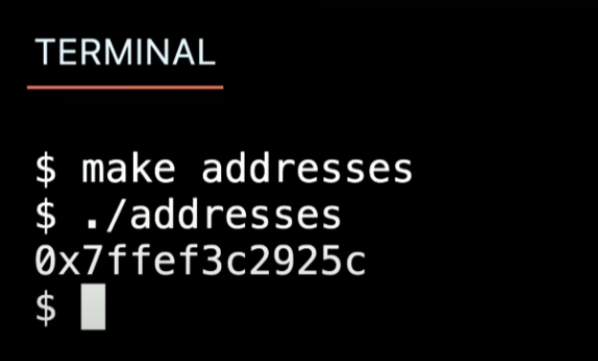
int n = 50;
int *p = &n;
Notes:
Why is hex so big? Memory is biiig these days!

Slide 73
Notes:
What did we just see?

Slide 74
 |  |  |  | 50 n
Notes:
Int n is 50

Slide 75
 |  |  |  | 50 0x123
Notes:
Int n 50 has an address

Slide 76
0x123 p
 |  |  |  | 50 0x123
Notes:
Pointer p stores the address
N is integer at that address

Slide 77
0x123 p
 |  |  |  | 50 0x123
Notes:
Pointer also stored in memory! 4 bytes versus 8 bytes!

Slide 78
p
 |  |  |  | 50 0x123
Notes:
Think of a Pointer as something that “points” to location of value in a “cubby hole”
MAILBOX DEMO

Slide 79
string
Notes:
String revisited (hint it is actually an array of chars)
“string” as a class is in cs50.h

Slide 80
string s = "HI!";

Slide 81
 |  |  | H | I | ! | \0

Slide 82
 |  |  | H s[0] | I s[1] | ! s[2] | \0 s[3]

Slide 83
 |  |  | H 0x123 | I 0x124 | ! 0x125 | \0 0x126
Notes:
Mem locations – NB 1 byte apart

Slide 84
s
 |  |  | H 0x123 | I 0x124 | ! 0x125 | \0 0x126
Notes:
addresses{4,5}.c

Slide 85
0x123 s
 |  |  | H 0x123 | I 0x124 | ! 0x125 | \0 0x126
Notes:
addresses{4,5}.c
NB pointer for a string is the starting address!
Script demonstrates the 1 byte increment
Printf() works print 1 char at a time until it hits the Null \0 char!

Slide 86
s
 |  |  | H 0x123 | I 0x124 | ! 0x125 | \0 0x126 | 0x127
Notes:
But who cares about the specific addresses, think of this just as a pointer literally, an arrow.

Slide 87
string s = "HI!";
Notes:
addresses6.c
Declaring a string

Slide 88
string s = "HI!";

Slide 89
char *s = "HI!";
Notes:
addresses7.c
DROP TRAINING WHEELS.
It's just an address.
String s is really same as char *s

Slide 90
typedef struct
{
string name;
string number;
} person;
Notes:
So what is "string"? It's a type we defined for you. In fact, recall how we made our own type last week for a person.

Slide 91
typedef struct
{
string name;
string number;
} person;

Slide 92
typedef struct
{
string name;
string number;
} person;

Slide 93
typedef struct
{
string name;
string number;
} person;

Slide 94
typedef
Notes:
For instance, you could alias "integer" to be the same as "int". But no need to do that.

Slide 95
typedef int

Slide 96
typedef int integer;

Slide 97
typedef

Slide 98
typedef char *

Slide 99
typedef char *string;

Slide 100
cs50.h
Notes:
Has some simplifications while we take on higher concepts like pointers

Slide 101
pointer arithmetic
Notes:
addresses{8,9,10}.c
Were these ints instead of chars, you would still do +1, and the compiler would know that it's really +4.

Slide 102
Notes:
compare0.c

Slide 103
50 i |  |  |  | 50 j

Slide 104
strcmp
Notes:
compare{1,2}.c
Have to type "HI!“
Comparing Hi! And HI! With == is actually comparing ADDRESSES...

Slide 106
s

Slide 107
s
 |  | H | I | ! | \0

Slide 108
s
 |  | H 0x123 | I 0x124 | ! 0x125 | \0 0x126

Slide 109
0x123 s
 |  | H 0x123 | I 0x124 | ! 0x125 | \0 0x126

Slide 110
0x123 s |  |  |  |  |  |  |  | t
 |  | H 0x123 | I 0x124 | ! 0x125 | \0 0x126

Slide 111
0x123 s |  |  |  |  |  |  |  | t
 |  | H 0x123 | I 0x124 | ! 0x125 | \0 0x126 |  |  |  |  | H | I | ! | \0

Slide 112
0x123 s |  |  |  |  |  |  |  | t
 |  | H 0x123 | I 0x124 | ! 0x125 | \0 0x126 |  |  |  |  | H 0x456 | I 0x457 | ! 0x458 | \0 0x459

Slide 113
0x123 s |  |  |  |  |  |  |  | 0x456 t
 |  | H 0x123 | I 0x124 | ! 0x125 | \0 0x126 |  |  |  |  | H 0x456 | I 0x457 | ! 0x458 | \0 0x459

Slide 114
s |  |  |  |  |  |  |  | t
 |  | H 0x123 | I 0x124 | ! 0x125 | \0 0x126 |  |  |  |  | H 0x456 | I 0x457 | ! 0x458 | \0 0x459
Notes:
compare{3,4}.c

Slide 115
Notes:
copy{0,1}.c
Have to use "hi!" in lowercase

Slide 116
s

Slide 117
s
 |  | h | i | ! | \0

Slide 118
s
 |  | h 0x123 | i 0x124 | ! 0x125 | \0 0x126

Slide 119
0x123 s
 |  | h 0x123 | i 0x124 | ! 0x125 | \0 0x126

Slide 120
0x123 s |  |  |  |  |  |  |  | t
 |  | h 0x123 | i 0x124 | ! 0x125 | \0 0x126

Slide 121
0x123 s |  |  |  |  |  |  |  | 0x123 t
 |  | h 0x123 | i 0x124 | ! 0x125 | \0 0x126

Slide 122
s |  |  |  |  |  |  |  | t
 |  | h 0x123 | i 0x124 | ! 0x125 | \0 0x126
Notes:
NB this demonstrates strcmp in the <string.h> header
When t is copy of s the memory address is recycled!!

Slide 123
s |  |  |  |  |  |  |  | t
 |  | H 0x123 | i 0x124 | ! 0x125 | \0 0x126
Notes:
If you change capitalisation at s, t also gets changed!!

Slide 124
malloc
free
…
Notes:
copy{2,3,4}.c
Point here is that memory allocation is important
If you make a new var you need to mallo() the space for it
Code demonstrates use of malloc()

Slide 125
s
 |  | h 0x123 | i 0x124 | ! 0x125 | \0 0x126

Slide 126
s |  |  |  |  |  |  |  | t
 |  | h 0x123 | i 0x124 | ! 0x125 | \0 0x126

Slide 127
s |  |  |  |  |  |  |  | t
 |  | h 0x123 | i 0x124 | ! 0x125 | \0 0x126 |  |  |  |  | 0x456 | 0x457 | 0x458 | 0x459
Notes:
Explicitly allocate memory chunk for t

Slide 128
s |  |  |  |  |  |  |  | t
 |  | h 0x123 | i 0x124 | ! 0x125 | \0 0x126 |  |  |  |  | 0x456 | 0x457 | 0x458 | 0x459

Slide 129
s |  |  |  |  |  |  |  | t
 |  | h 0x123 | i 0x124 | ! 0x125 | \0 0x126 |  |  |  |  | h 0x456 | 0x457 | 0x458 | 0x459
Notes:
Iterate over s in for loop (next few slides)

Slide 130
s |  |  |  |  |  |  |  | t
 |  | h 0x123 | i 0x124 | ! 0x125 | \0 0x126 |  |  |  |  | h 0x456 | i 0x457 | 0x458 | 0x459

Slide 131
s |  |  |  |  |  |  |  | t
 |  | h 0x123 | i 0x124 | ! 0x125 | \0 0x126 |  |  |  |  | h 0x456 | i 0x457 | ! 0x458 | 0x459

Slide 132
s |  |  |  |  |  |  |  | t
 |  | h 0x123 | i 0x124 | ! 0x125 | \0 0x126 |  |  |  |  | h 0x456 | i 0x457 | ! 0x458 | \0 0x459
Notes:
Now if you change case in s, t has it’s own mem and is not changed

Slide 133
s |  |  |  |  |  |  |  | t
 |  | h 0x123 | i 0x124 | ! 0x125 | \0 0x126 |  |  |  |  | H 0x456 | i 0x457 | ! 0x458 | \0 0x459

Slide 134
NULL
Notes:
copy5.c
Malloc() can fail so need an error check
NB need free() to release memory to avoid MEMORY LEAKS

Slide 135
valgrind
Notes:
memory.c, create in advance
[Note: not necessary to free strings returned by get_string, CS50's library does for you.]
Find bugs
No zero index
No free(x)
valgrind terminal command program that evaluates memory use in programs
valgrind ./memory

Slide 136
garbage values
Notes:
garbage.c
-remnants of something that was in memory
garbage | less (pipe less paginates command line output

Slide 137
int main(void)
{
int *x;
int *y;
x = malloc(sizeof(int));
*x = 42;
*y = 13;
y = x;
*y = 13;
}
Notes:
*x = 42;
Goto value of x and put 42 there.

Slide 138
int main(void)
{
int *x;
int *y;
x = malloc(sizeof(int));
*x = 42;
*y = 13;
y = x;
*y = 13;
}

Slide 139
int main(void)
{
int *x;
int *y;
x = malloc(sizeof(int));
*x = 42;
*y = 13;
y = x;
*y = 13;
}

Slide 140
int main(void)
{
int *x;
int *y;
x = malloc(sizeof(int));
*x = 42;
*y = 13;
y = x;
*y = 13;
}

Slide 141
int main(void)
{
int *x;
int *y;
x = malloc(sizeof(int));
*x = 42;
*y = 13;
y = x;
*y = 13;
}

Slide 142
int main(void)
{
int *x;
int *y;
x = malloc(sizeof(int));
*x = 42;
*y = 13;
y = x;
*y = 13;
}
Notes:
So maybe we shouldn't do that

Slide 143
int main(void)
{
int *x;
int *y;
x = malloc(sizeof(int));
*x = 42;
*y = 13;
y = x;
*y = 13;
}
Notes:
But what if we instead…

Slide 144
int main(void)
{
int *x;
int *y;
x = malloc(sizeof(int));
*x = 42;
*y = 13;
y = x;
*y = 13;
}

Slide 145
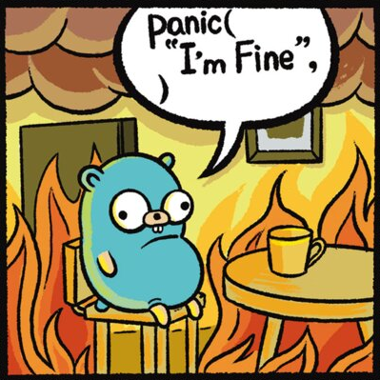
Notes:
https://www.youtube.com/watch?v=3uLKjb973HU

Slide 146
void swap(int a, int b)
{
}
Notes:
A lot of last week's demos involved swapping…
DRINKING GLASS DEMO – requires a temp variable (like glasses demo)

Slide 147
void swap(int a, int b)
{
int tmp = a;
a = b;
b = tmp;
}
Notes:
swap0.c
Have this one ready to go in a swap.c file
Programe code demonstrates that successful swap in local function does not affect global vars in main()

Slide 148
void swap(int a, int b)
{
int tmp = a;
a = b;
b = tmp;
}
Notes:
Beware local scope (versus global)

Slide 149
scope

Slide 150
passing by value
Notes:
Passing “copies” of values, rather than changing the original

Slide 151
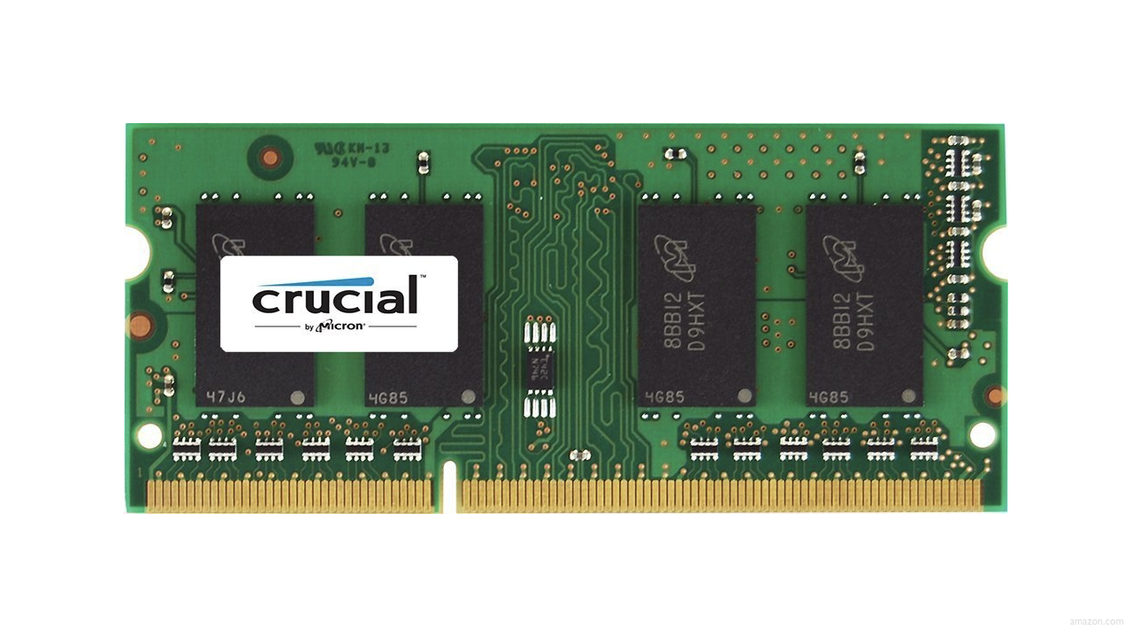

Slide 154
Notes:
Memory used in different ways

Slide 155
↑
stack

Slide 156
machine code
↑
stack
Notes:
Machine code in one space

Slide 157
machine code
globals
heap
↓
↑
stack
Notes:
Global vars loaded lower in stack

Slide 158
machine code
globals
heap
↓
↑
stack
Notes:
Malloc() uses memory in the “heap”

Slide 159
machine code
globals
heap
↓
↑
stack

Slide 160
machine code
globals
heap
↓
↑
stack
Notes:
Stack grows upward (see wk 4 tutorial)

Slide 161
machine code
globals
heap
↓
↑
stack

Slide 162
↑
stack
Notes:
show swap0.c again

Slide 163
void swap(int a, int b)
{
int tmp = a;
a = b;
b = tmp;
}

Slide 164
main
Notes:
Main gets a chuink of mem in stack

Slide 165
swap
main
Notes:
Function calls get added on top

Slide 166
main

Slide 167
x
y

Slide 168
1
x
2
y

Slide 169
swap
1
x
2
y

Slide 170
a
b
tmp
1
x
2
y

Slide 171
1
a
2
b
tmp
1
x
2
y

Slide 172
int tmp = a;
a = b;
b = tmp;
1
a
2
b
tmp
1
x
2
y

Slide 173
int tmp = a;
a = b;
b = tmp;
1
a
2
b
1
tmp
1
x
2
y

Slide 174
int tmp = a;
a = b;
b = tmp;
2
a
2
b
1
tmp
1
x
2
y
Notes:
Swapping happens

Slide 175
int tmp = a;
a = b;
b = tmp;
2
a
1
b
1
tmp
1
x
2
y

Slide 176
2
a
1
b
1
tmp
1
x
2
y

Slide 177
1
x
2
y

Slide 178
passing by reference
Notes:
so how fix?

Slide 179
void swap(int a, int b)
{
int tmp = a;
a = b;
b = tmp;
}

Slide 180
void swap(int *a, int *b)
{
int tmp = *a;
*a = *b;
*b = tmp;
}
Notes:
Here passing by refernce

Slide 181
void swap(int *a, int *b)
{
int tmp = *a;
*a = *b;
*b = tmp;
}
Notes:
swap1.c
We need to actually swap using pointers

Slide 182
1
x
2
y

Slide 183
a
b
tmp
1
x
2
y
Notes:
Passing by reference here

Slide 184
int tmp = *a;
*a = *b;
*b = tmp;
a
b
tmp
1
x
2
y

Slide 185
int tmp = *a;
*a = *b;
*b = tmp;
a
b
1
tmp
1
x
2
y

Slide 186
int tmp = *a;
*a = *b;
*b = tmp;
a
b
1
tmp
2
x
2
y

Slide 187
int tmp = *a;
*a = *b;
*b = tmp;
a
b
1
tmp
2
x
1
y

Slide 188
a
b
1
tmp
2
x
1
y

Slide 189
2
x
1
y

Slide 190
void swap(int a, int b)
{
int tmp = a;
a = b;
b = tmp;
}

Slide 191
void swap(int *a, int *b)
{
int tmp = *a;
*a = *b;
*b = tmp;
}

Slide 192
machine code
globals
heap
↓
↑
stack
Notes:
NB you CAN sometimes run out of memory

Slide 193
heap
↓
↑
stack
Notes:
What's bad about this picture?

Slide 194
heap overflow
stack overflow
Notes:
Calls a lot of functions that “overflow”

Slide 195
buffer overflow
Notes:
Over allocating to reserved memory

Slide 196


Notes:
https://www.youtube.com/watch?v=9m_YXDrRkic

Slide 197
"Sensors that received the new version of Channel File 291 carrying the problematic content were exposed to a latent out-of-bounds read issue in the Content Interpreter. At the next IPC notification from the operating system, the new IPC Template Instances were evaluated, specifying a comparison against the 21st input value. The Content Interpreter expected only 20 values. Therefore, the attempt to access the 21st value produced an out-of-bounds memory read beyond the end of the input data array and resulted in a system crash."
Notes:
https://www.crowdstrike.com/wp-content/uploads/2024/08/Channel-File-291-Incident-Root-Cause-Analysis-08.06.2024.pdf

Slide 198
"Sensors that received the new version of Channel File 291 carrying the problematic content were exposed to a latent out-of-bounds read issue in the Content Interpreter. At the next IPC notification from the operating system, the new IPC Template Instances were evaluated, specifying a comparison against the 21st input value. The Content Interpreter expected only 20 values. Therefore, the attempt to access the 21st value produced an out-of-bounds memory read beyond the end of the input data array and resulted in a system crash."
Notes:
Danger of automatic updates!

Slide 199
get_char
get_double
get_float
get_int
get_long
get_string
...
Notes:
So how about these other training wheels?

Slide 200
get_int
Notes:
get0.c
How much space do we need when soliciting user input?

Slide 201
scanf
…
Notes:
get1.c
Scanf() gets input and stores it at the address where n is

Slide 202
Notes:
Idea of garbage values

Slide 203


Slide 204
 | 50 n

Slide 206
Notes:
get2.c

Slide 207
s

Slide 208
s

Slide 209
s

Slide 211
Notes:
get3.c

Slide 212
s
Notes:
get3.c
get_int allocates just enough memory + 1

Slide 213
file I/O
Notes:
File input and output

Slide 214
fopen
fclose
fprintf
fscanf
fread
fwrite
fseek
…
Notes:
phonebook{0,1}.c
Function related to files
Experiment with the code files to look at file functions functionality!

Slide 215

Notes:
cp.c
https://stock.adobe.com/search/video?k=progress+bar
Cp.c demonstrates copy
NB use of pointers
NB the while loop iterates over value byte by byte
-byte reading in cp.c is a lot like a youtube video in that it reads consecutively

Slide 216
BMP
Notes:
Finally, bitmap

Slide 217

Notes:
Reading pixels top to bottom, left to right

Slide 218
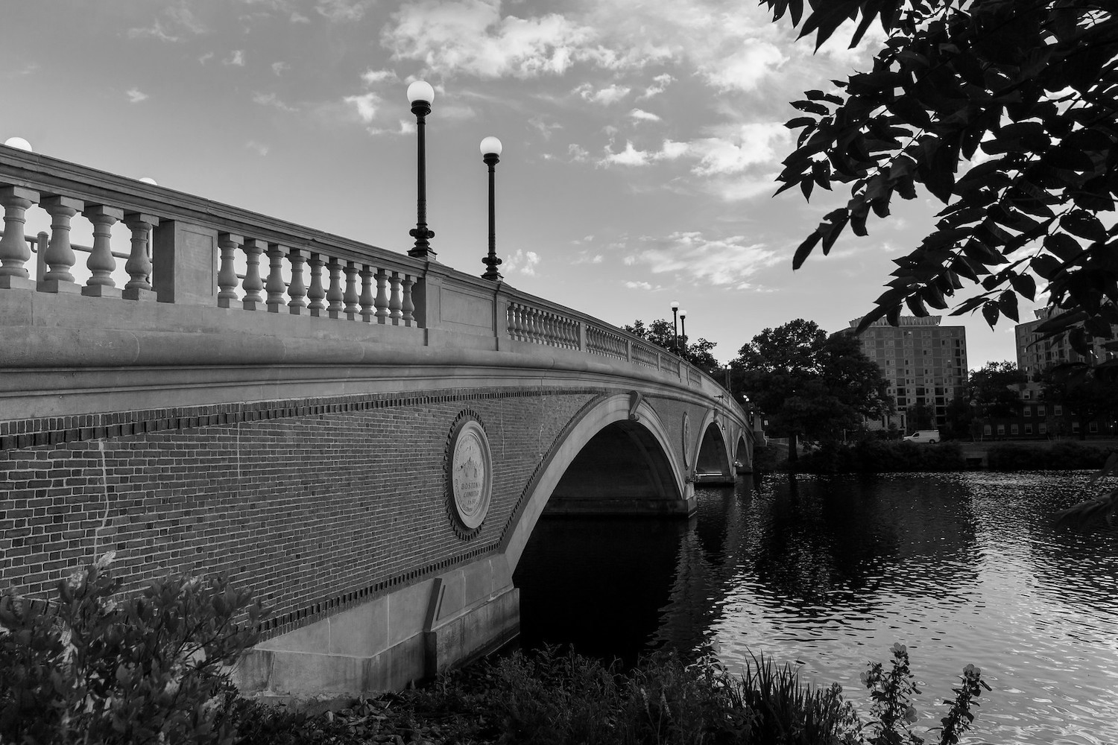
Notes:
Grayscale throws away colour

Slide 219
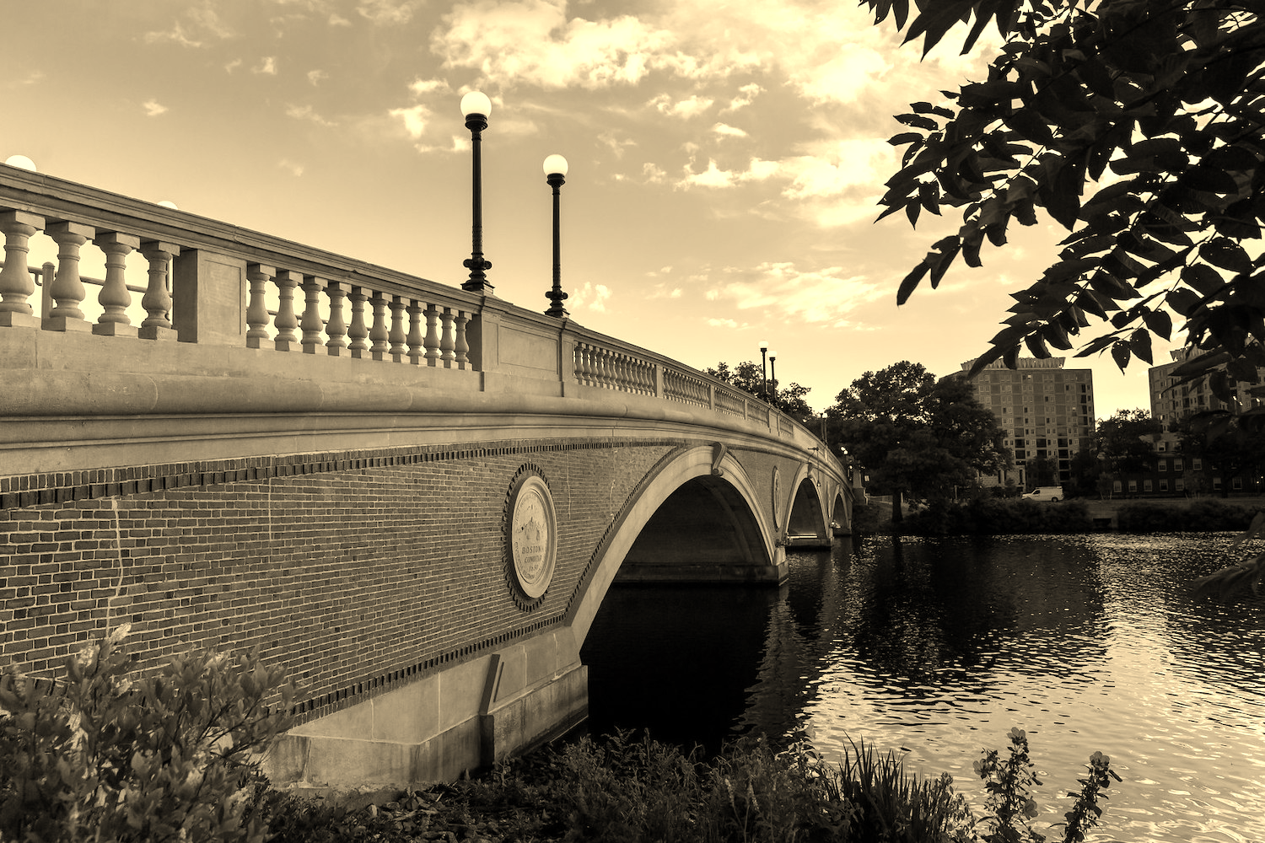
Notes:
sepia

Slide 220

Notes:
Reflect flips the image

Slide 221

Notes:
Blur combines pixel values

Slide 222

Notes:
edge detection

Slide 223
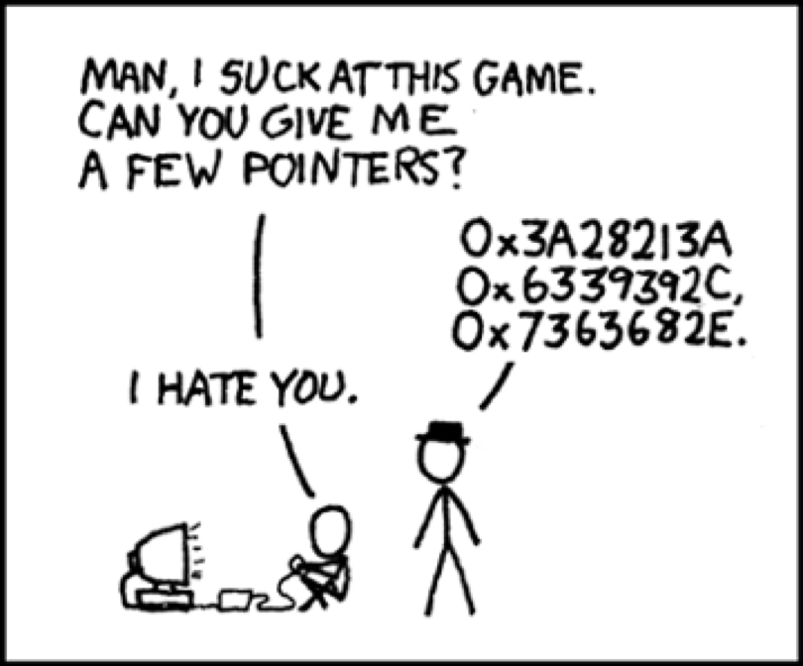
Notes:
https://xkcd.com/138/

Slide 224
Computing Technology

